Slide 1


Artificial Intelligence (Machine Learning & Deep Learning)
NAVTTC & Strings Technologies
by Salman Ahmad

Slide 2
Outline Week 7 Day 2
MLP Feed Forward Neural Network
Forward and backward passes
Nonlinearity: Activation functions
Cross-Entropy
Computational graph and Backpropagation
Vanishing and exploding gradients
Overfitting, underfitting, dropout regularization

Slide 3
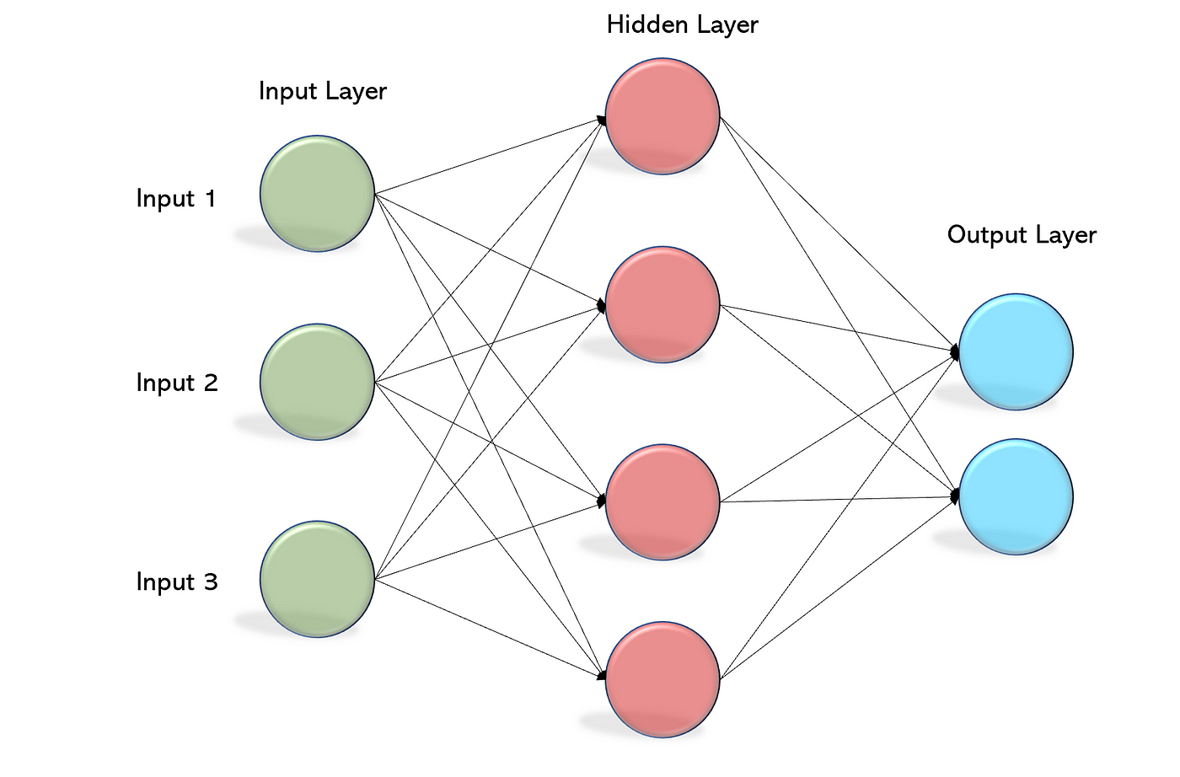
What is an MLP (Feedforward Neural Network)?
A Multilayer Perceptron (MLP) is a type of Feedforward Neural Network.
Composed of:
Input layer
1 or more hidden layers
Output layer
Each layer performs:
Z = Wx + b , a = σ ( z )
Where σ is a nonlinear activation function.

Slide 4
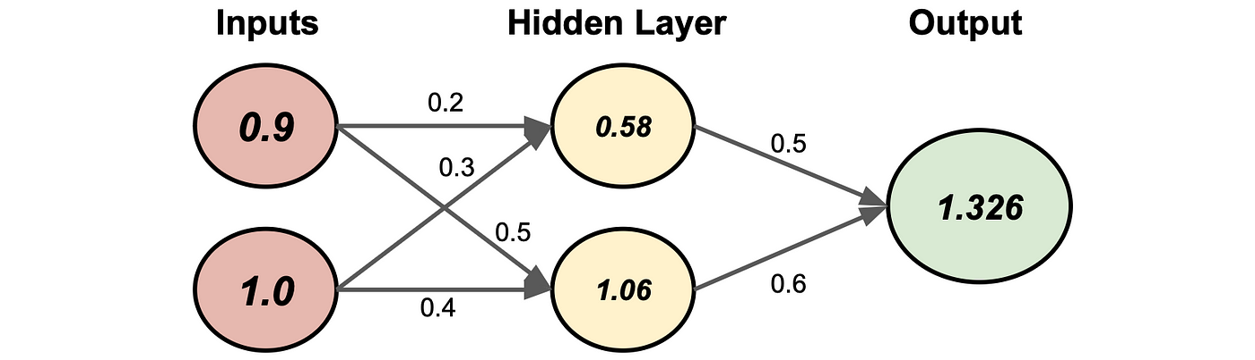
Forward Pass (Inference)
Input flows layer by layer to compute the output.
At each layer:
Compute linear combination: z=Wx+b
Apply activation: a=σ(z)
Final output is used for prediction or loss calculation.

Slide 5
Backward Pass (Training)
Uses Backpropagation to update weights.
Steps:
Compute loss: L(y^,y)
Compute gradients of loss w.r.t. output
Propagate gradients backward through the network
Update weights using Gradient Descent:
W ← W − η⋅ (∂L / ∂W)​

Slide 6
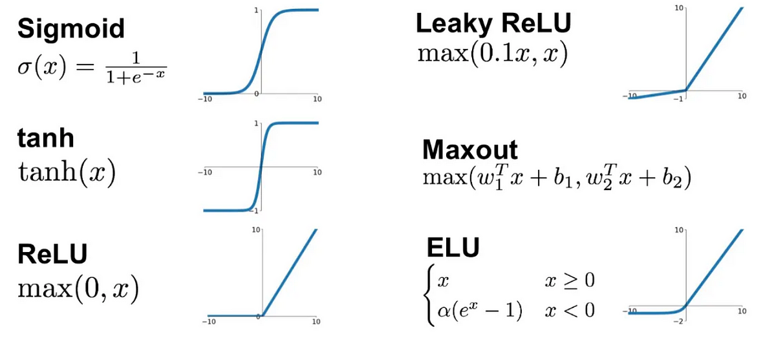
Nonlinearity – Activation Functions
Nonlinearities allow neural networks to approximate complex functions.
Example:

Slide 7
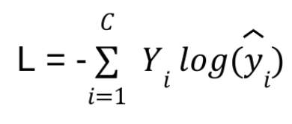
Cross-Entropy Loss
Used in classification problems:
Where:
y_{i}: true label (one-hot)
y^_{​i}​: predicted probability from softmax
Encourages high confidence for correct classes.

Slide 8
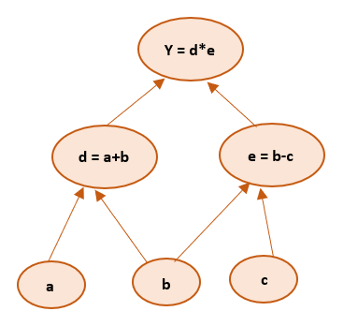
Computational Graph & Backpropagation
A computational graph is a directed graph used to represent mathematical expressions or algorithms
A neural network can be viewed as a computational graph
Backpropagation = reverse-mode automatic differentiation
We use the chain rule to compute gradients from output to input

Slide 9
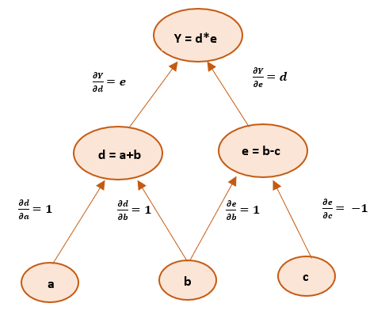
Computational Graph & Backpropagation
In backpropagation, partial derivatives are calculated and propagated backward throughout the network
Computational graph helps in calculating derivatives/gradients
The computation graph can be static or dynamic

Slide 10
Vanishing and Exploding Gradients
In deep networks:
Gradients can shrink (vanish) with sigmoid/tanh
Or explode with large weights or ReLU
Problem: Poor learning or unstable updates
Example: Sigmoid function
Max derivative: 0.25
If you stack 20 layers:
Gradient∼(0.25)²⁰ = 1.0e⁻¹²
That’s nearly zero — the gradient disappears.

Slide 11
Vanishing and Exploding Gradients
Solutions:
Use ReLU, LayerNorm, or BatchNorm
Use proper weight initialization
Use residual connections (ResNets)

Slide 12
Overfitting & Underfitting
Phenomenon | Description | Solution
Underfitting | Model too simple, can't capture patterns | Add layers, train longer
Overfitting | Model memorizes training data | Use regularization, dropout, early stopping

Slide 13
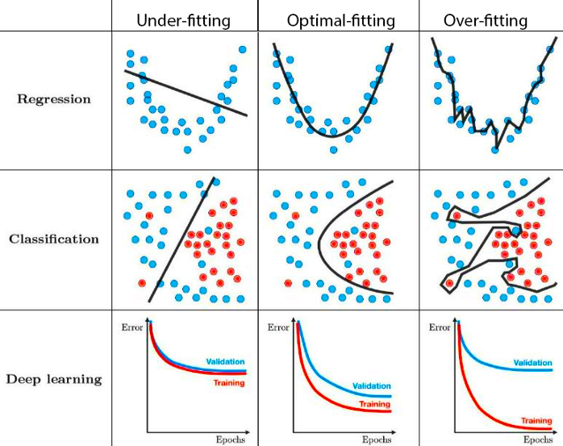
Overfitting & Underfitting

Slide 14
Practice Task
Explore TensorFlow Playground
Try:
Linear and non-linear network
Different number of layers
Different number of nodes per layer
Learning Rate
Regularization

Slide 15
Practice Task
Build a 3-layer MLP using TensorFlow/Keras
Train on:
MNIST (digits)
IMDB (sentiment) — with word embeddings
Try adding:
Dropout
ReLU vs. Tanh
Cross-entropy vs. MSE loss
Plot training & validation accuracy

Slide 16

Questions?
"He who asks a question is a fool for a minute; he who does not remains a fool forever." – Confucius

